Slide 1
Introduction to Normalization

Slide 2
Normalization is the process of successively reducing relations with anomalies to produce smaller, well-structured relations. Following are some of the main goals of normalization:
Minimize data redundancy, thereby avoiding anomalies and conserving storage space.
Simplify the enforcement of referential integrity constraints.
Make it easier to maintain data (insert, update, and delete)
Provide a better design that is an improved representation of the real world and a stronger basis for future growth.

Slide 3
Normalization is the process of applying a set of rules to tables that have been identified in order to simplify them. Its aim is to highlight dependencies between the various data items and reduce them.
The process:
1NF(first normal form): A table or relation is said to be in first normal form iff it contains no repeating groups. If there are repeating groups they should be isolated to form a new entity.
2NF (second normal form): A table is said to be in 2NF iff it is in 1NF and every non-key attribute is fully dependent in the key attribute. All non-key attributes not fully dependant on the key attribute should be isolated to form a new entity.
3NF (third normal form): A table is said to be in 3NF iff it is in 2NF and every non-key attribute is not dependent on any other non-key attribute. All non-key attributes dependent on other non-key attributes should be isolated to form a new entity.

Slide 4
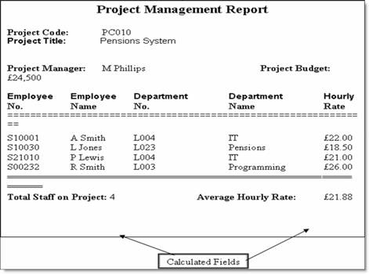

Slide 5
Unormalized(project_code, project_title, Project_manager, project_budget, employee_no, employee_name, department_no, department_name, Hourly_rate)

Slide 7
Fiction Company has provided you with the report below. The unit price is negotiable. Their requirement is for you to create a database for them. Describe the process you would follow to ensure you present to Fiction a database representation that has functional dependencies minimized

Slide 8
